Slide 1

Stock Market Data Analysis and Prediction
Exploratory Data Analysis, Machine Learning, and Deployment

Slide 2

Problem Statement
Accurately predicting stock prices is crucial for financial decision-making. This project applies machine learning to analyze and predict stock prices.

Slide 3

Data Description
Dataset includes columns like 'date', 'open', 'high', 'low', 'close', and 'volume'.
Preprocessing involved handling missing values and converting features for analysis.

Slide 4
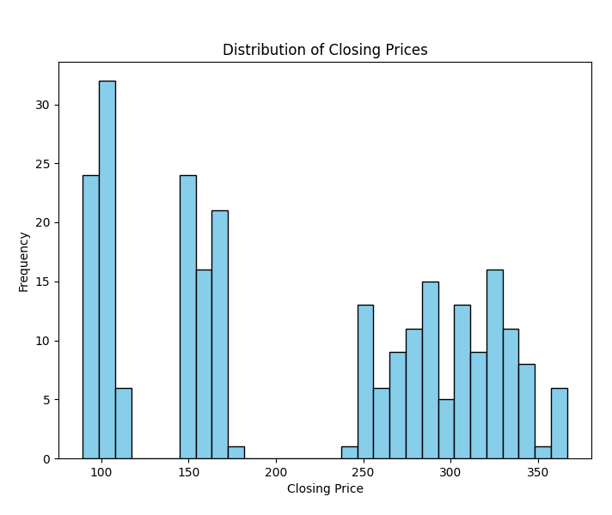
Distribution of Closing Prices

Slide 5
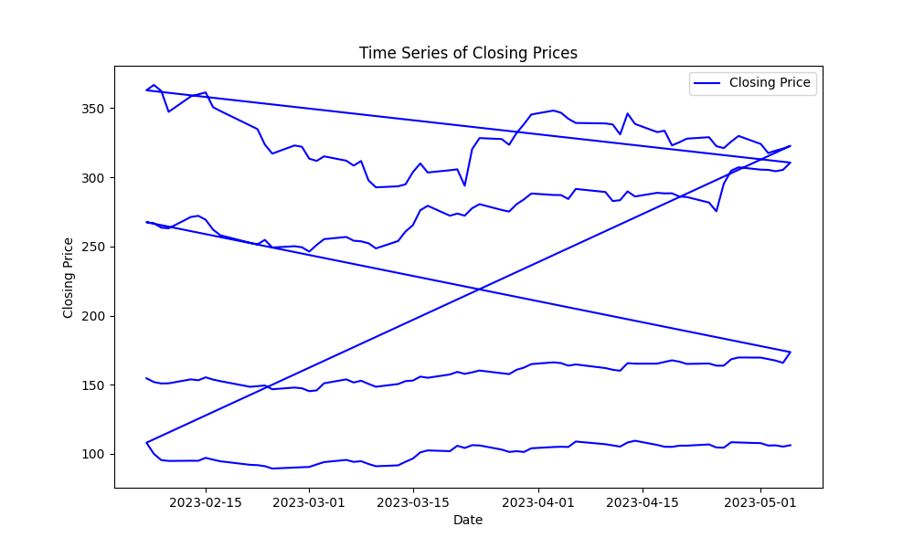
Time Series of Closing Prices

Slide 6

Feature Engineering
Moving Averages (10-day, 50 day): Highlights short-term and long-term trends.
Volatility: Standard deviation over a 10-day rolling window.
These features enhance model accuracy.

Slide 7
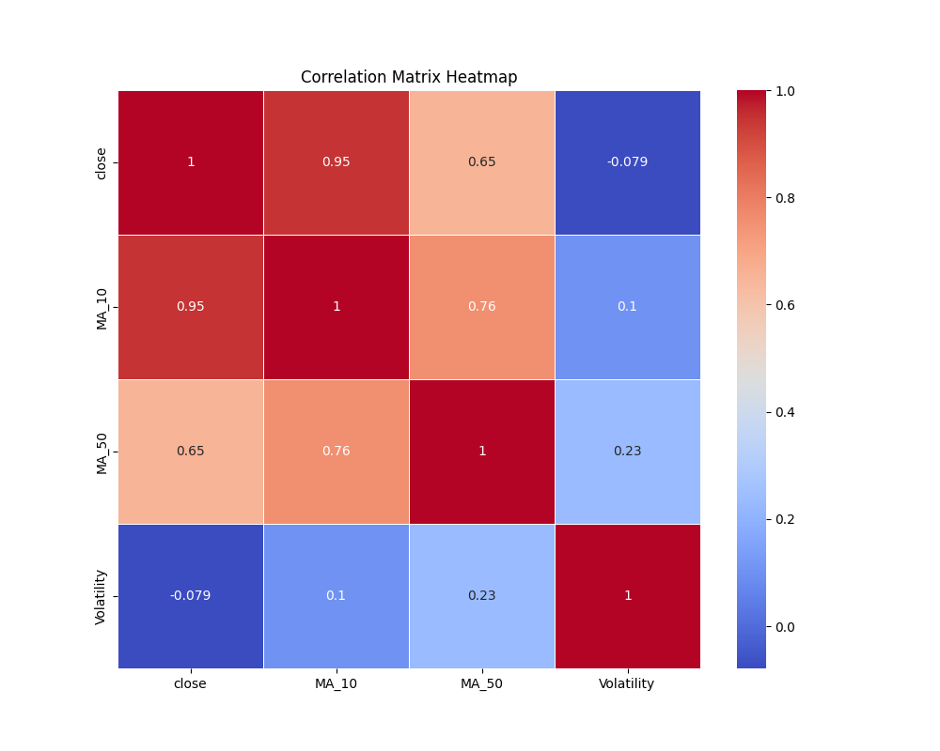
Correlation Heatmap

Slide 8
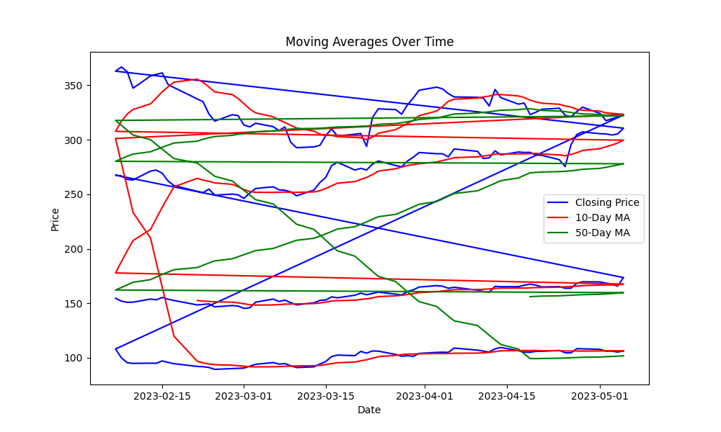
Moving Averages Over Time

Slide 9
Modeling Techniques
- Linear Regression: A baseline predictive model.
- Decision Tree Regressor: Captures non-linear patterns.
- Random Forest Regressor: Ensemble model for robust predictions.
- ARIMA: Time-series analysis for forecasting.

Slide 10
Model Comparison
- Linear Regression R²: 0.85
- Decision Tree Regressor R²: 0.89
- Random Forest Regressor R²: 0.92
Best model: Random Forest Regressor

Slide 11
Model Deployment
- Flask API created for real-time predictions.
- Scaler and model serialized with pickle.
- API accepts JSON input and returns stock price predictions.

Slide 12

Conclusion and Future Work
Conclusion:
Successfully analyzed stock data and built predictive models.
Random Forest performed best in predicting stock prices.
Future Work:
Test with real-time data.
Incorporate advanced models like LSTMs for time-series analysis.

